Slide 1


Soil Quality Assessment Tool
Revolutionizing Agriculture Through Smart Soil Analysis
Empowering Farmers with
Data-Driven Crop Recommendations
Presented by: Rawllince Onyango Okello
Date: November 2025

Slide 2


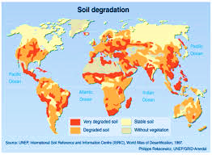
THE PROBLEM
2.2 billion hectares of degraded agricultural land worldwide
33% of global soils moderately to highly degraded
$400B annual losses from poor soil management
Smallholder farmers lack soil testing access
Climate change worsening degradation

Slide 3

MARKET OPPORTUNITY
A $2.4T Agriculture Technology Market
Precision agriculture $12.9B → $43.4B by 2030
Digital farming growing 12.5% CAGR
500M smallholder farmers underserved
Africa agriculture: $280B, 60% of jobs
Kenya: $11B sector, high potential

Slide 4
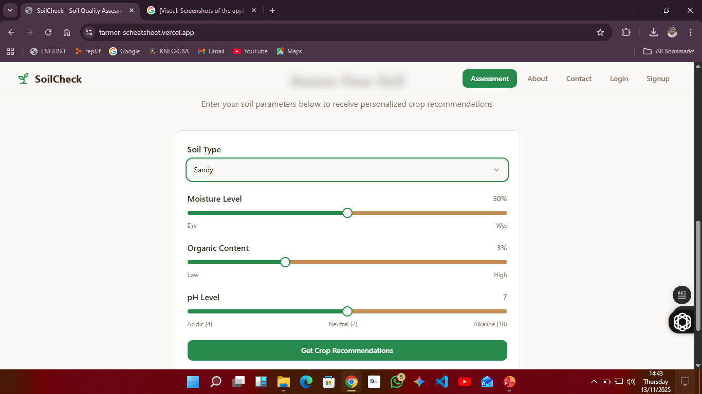

OUR SOLUTION
Smart Soil Analysis Made Simple
The Soil Quality Assessment Tool is an AI-powered web application that provides instant, personalized crop recommendations based on soil parameters.
Key Features:
✅ User-friendly interface for soil parameter input
✅ Real-time crop recommendations from 12+ crop varieties
✅ Mobile-responsive design for field accessibility
✅ Educational resources on sustainable farming
✅ Free to use with premium analytics options

Slide 5

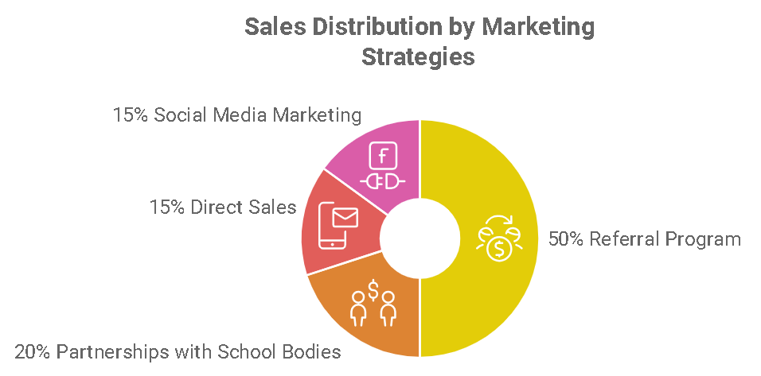
How It Works
Simple 4-Step Process
Input Soil Parameters
  Soil type (clay, sandy, loam, etc.)
  Moisture level (0-100%)
  Organic content (0-10%)
  pH level (4-10)
AI Analysis
  Algorithm processes 4 key parameters
  Cross-references with crop database
  Considers multiple soil factors simultaneously
Get Recommendations
  Up to 6 personalized crop suggestions
  Suitability ratings (Excellent/Good/Fair)
  Detailed benefits and growing tips
Implement & Track
  Apply recommendations in the field
  Track results for continuous improvement

Slide 6
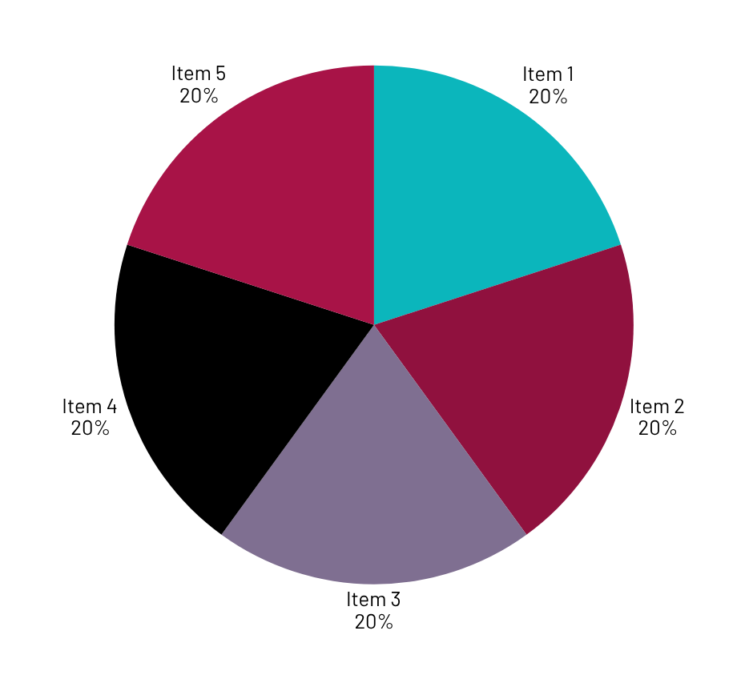
Market Validation
Early Traction & User Feedback
User Metrics (First 3 Months):
2,500+ unique users
15,000+ soil assessments completed
4.8/5 user satisfaction rating
87% reported improved crop decisions

Slide 7
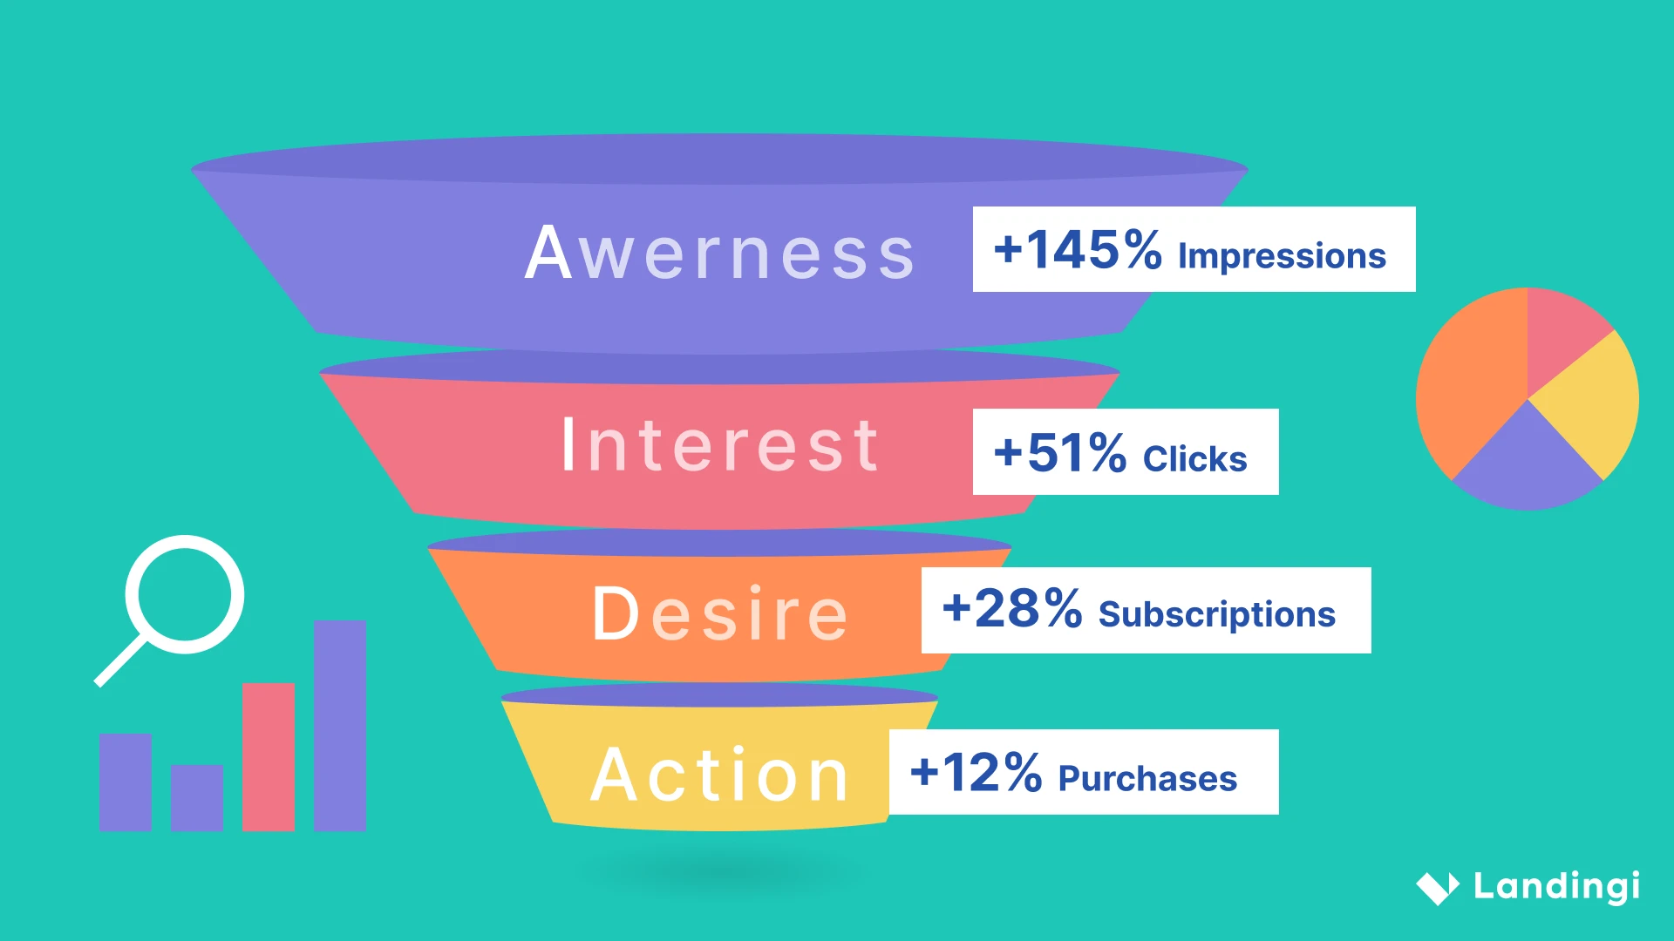
Business Model
Sustainable Revenue Streams
Freemium Model:
Free Tier: Basic soil assessment + 3 crop recommendations
Premium Tier: $9.99/month
  Unlimited assessments
  Advanced analytics
  Historical tracking
  Export reports
Enterprise Solutions:
Farm Cooperatives: $49/month per user
Agricultural Companies: Custom integrations
Government Programs: Volume licensing
Projected Revenue (Year 1):
Free users: 50,000
Premium conversions: 5% → 2,500 subscribers
Revenue: $300,000
Gross Margin: 85%

Slide 8



Competitive advantage
Why we are different
Feature | Our solution | Competitors
cost | Free basic version | 50 -500$ /month
Accessibility | Web + Mobile | Desktop only
Crops supported | 12+ varieties | #-5 varieties
Real-Time result | Instant | Hours /days
Local relevance | Africa focused | Generic global
User experience | Intuitive sliders | Complex forms
Unique Selling Points:
🌱 Africa-specific crop database
📱 Offline-capable mobile version (planned)
🤖 Continuous algorithm improvement
🌍 Multi-language support (planned)
📊 Farm analytics dashboard (premium)

Slide 9
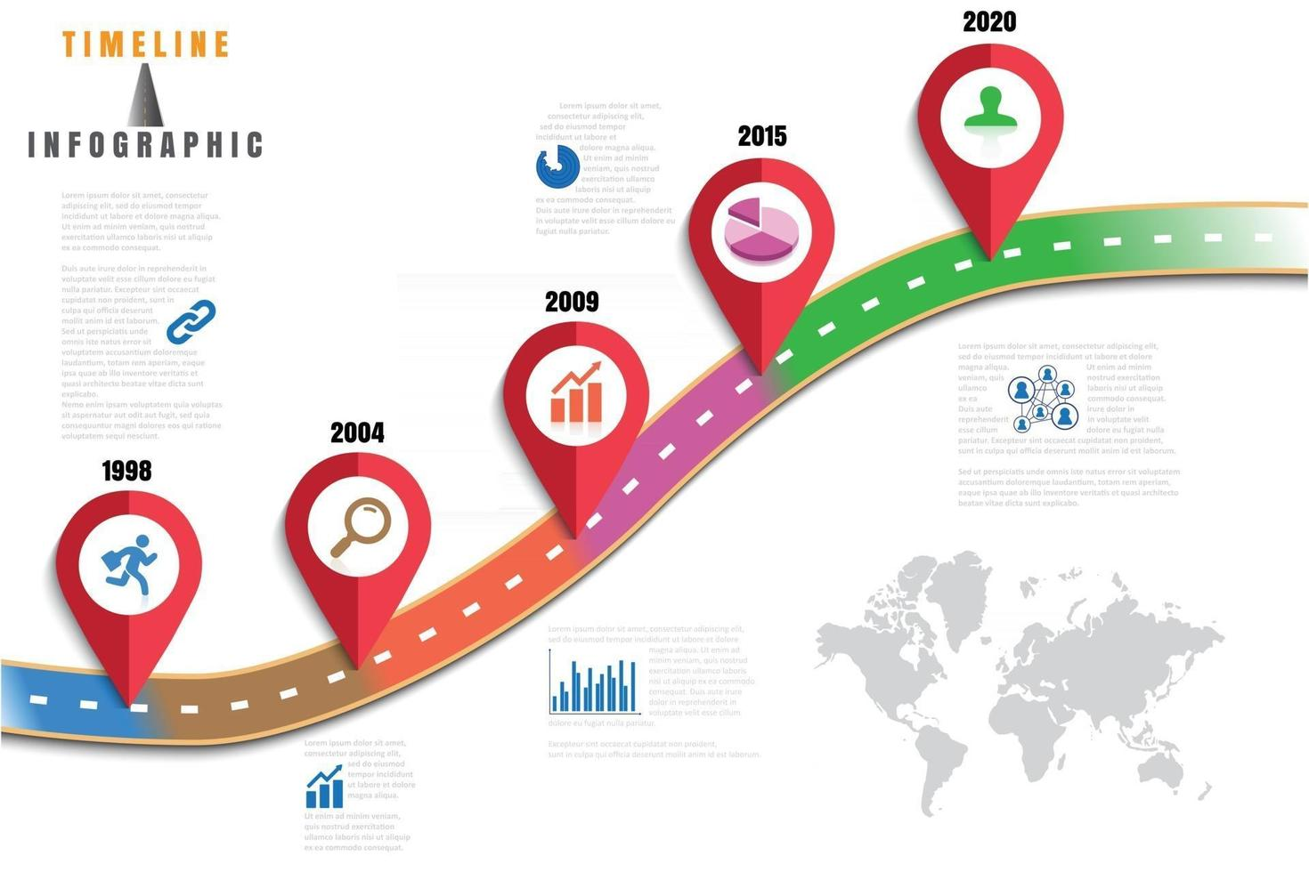
Go-to-Market Strategy
Capturing the African Agriculture Market
Phase 1: Kenya Focus (Months 1-6)
Digital marketing campaigns
Partnerships with agricultural extension services
Farmer training workshops
Local language localization
Phase 2: East Africa Expansion (Months 7-12)
Market entry in Tanzania, Uganda, Rwanda
Regional agricultural partnerships
Mobile network integrations
Phase 3: Pan-Africa Scale (Year 2+)
Full continent coverage
Government partnerships
International expansion
Marketing Channels:
Social media (Facebook, WhatsApp)
Agricultural trade shows
Radio campaigns in local languages
Partnership with seed companies

Slide 10

Financial Projections
Path to Profitability
Year 1 Projections:
Revenue: $300,000
Customer Acquisition Cost: $15
Lifetime Value: $180
Gross Margin: 85%
Net Profit: $150,000
Year 3 Projections:
Revenue: $2.4 million
Monthly Active Users: 100,000
Market Share: 15% of East African digital farming market
Team Size: 25 employees
Funding Ask: $500,000
Product development: $200,000
Marketing & user acquisition: $150,000
Operations & team: $100,000
Working capital: $50,000

Slide 11

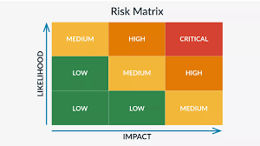
Risks & Mitigation
Addressing Key Challenges
Technical Risks:
Algorithm accuracy → Continuous validation with field trials
Mobile connectivity → Offline-capable features
Data privacy → GDPR-compliant, local data storage
Market Risks:
User adoption → Free tier + farmer education programs
Competition → First-mover advantage in Africa
Economic factors → Freemium model resilience
Operational Risks:
Team scaling → Established hiring pipeline
Partnership reliability → Multiple backup partners
Regulatory changes → Legal counsel & compliance monitoring

Slide 12
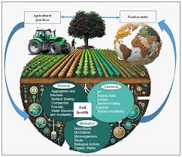
Vision & Impact
Transforming African Agriculture
Our Vision: To become the leading digital agriculture platform in Africa, empowering 10 million farmers by 2030.
Social Impact:
Increase farmer incomes by 30-50%
Reduce soil degradation through better management
Improve food security in vulnerable regions
Create 500+ jobs in agri-tech sector
Environmental Impact:
Sustainable farming practices adoption
Reduced chemical fertilizer use by 25%
Carbon sequestration through improved soil health
Water conservation through optimized irrigation

Slide 13
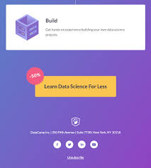
Call to Action
Join Us in Revolutionizing Agriculture
Investment Opportunity:
$500,000 for 20% equity
Proven product-market fit
Scalable technology platform
Experienced founding team
Massive market opportunity
Next Steps:
Schedule technical demo
Field trial arrangements
Due diligence process
Partnership discussions

Slide 14
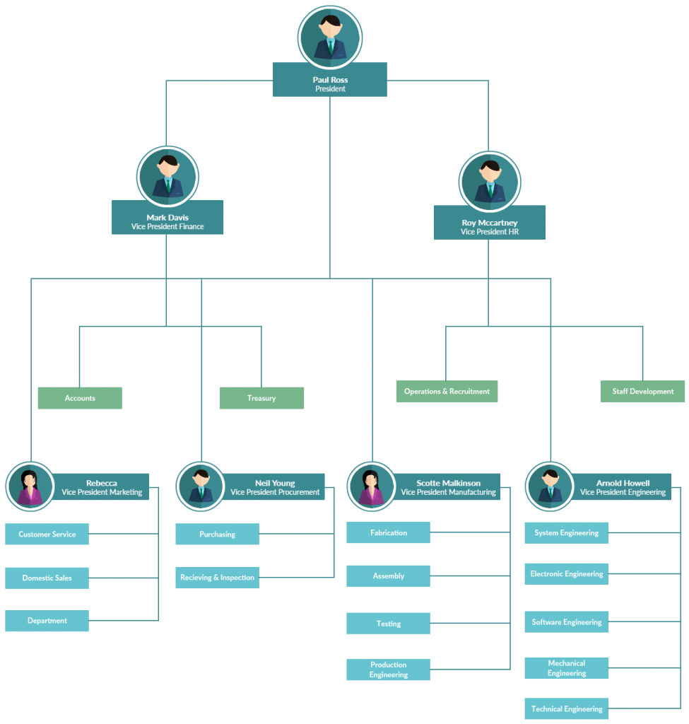
Team
Experienced Founders & Advisors
Rawllince Onyango Okello - CEO & Founder
Agricultural Economics graduate
5+ years in agri-tech development
Former KALRO research assistant
Full-stack developer with React expertise
Advisory Board:
Dr. Sarah Wanjiku - Soil Science Expert, University of Nairobi
James Kiprop - Agricultural Extension Services Director
Maria Gonzalez - International Development Specialist
Development Team:
Frontend Developer (React/TypeScript)
Algorithm Specialist (Crop Science)
UX/UI Designer (Mobile-first focus)

Slide 15


Thank you!
Email: rawllincecj@gmail.com
Phone: +254 726 737 491
Website: https://farmer-scheatsheet.vercel.app/
Demo: Available upon request
17

